Slide 1
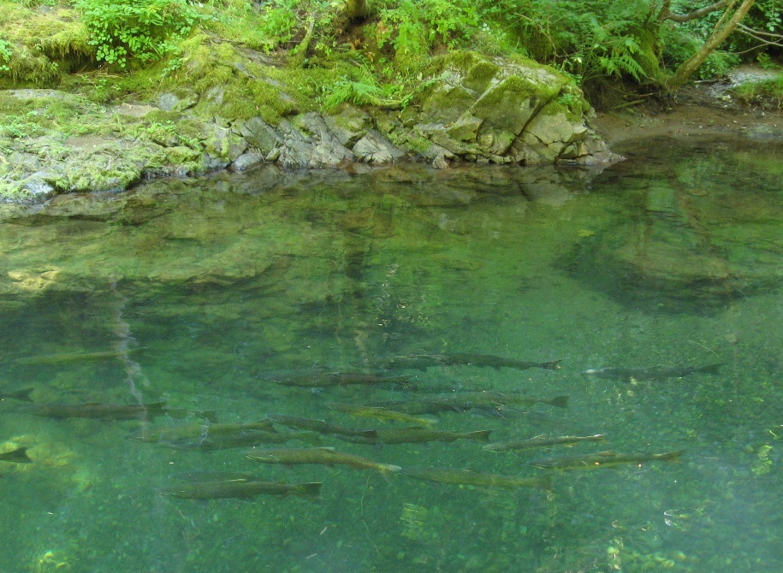
Oregon Department of Fish and Wildlife’s Willamette Chinook Salmon (OWCS) Database, β version
Benjamin Clemens* Kirk Schroeder Brian Cannon
Luke Whitman, Cameron Sharpe
2014 Willamette Fisheries Science Review

Slide 2
Acknowledgments
U.S. Army Corps of Engineers
David Griffith
Dozens of field staff

Slide 3
Overview
ODFW mission, etc.
Rapid incr.: “Big data”, data sharing
Databases
Distributed research teams
Overview of OWCS database
Benefits
Outputs
Some examples
If you want to collaborate….

Slide 4
Oregon Department of Fish and Wildlife (ODFW)
Guiding statutory reference
Manage fisheries
ODFW mission
R, M & E
ODFW principle

Slide 5
Guiding statutory reference
Food fish management policy. Food fish shall be managed to provide the optimum economic, commercial, recreational and aesthetic benefits for present and future generations of the citizens of this state. (Oregon Revised Statutes 506.109)

Slide 6
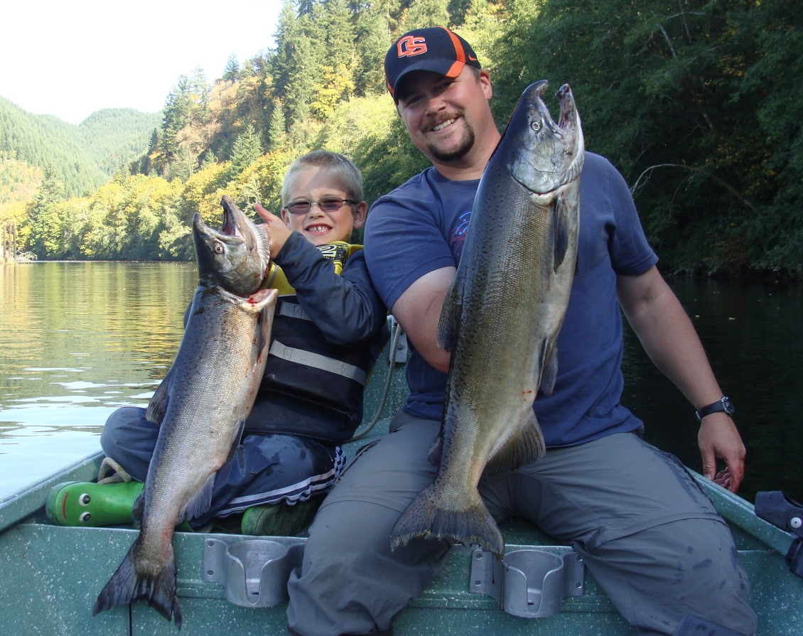
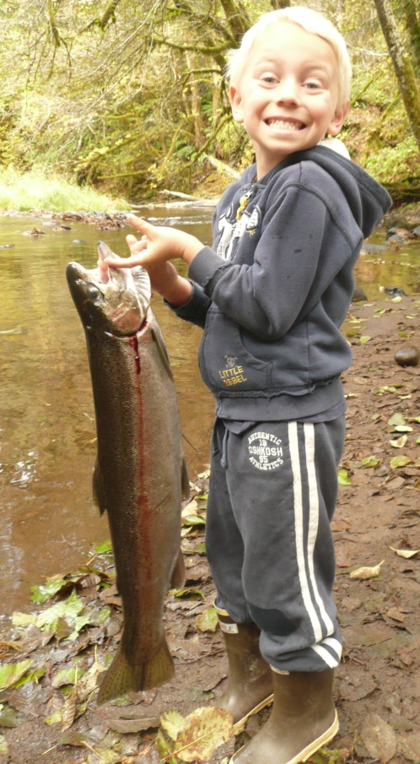
Mission
To protect and enhance Oregon's fish and wildlife and their habitats for use and enjoyment by present and future generations.
Photo: Jeremy Romer
Photo: Paul Olmsted

Slide 7
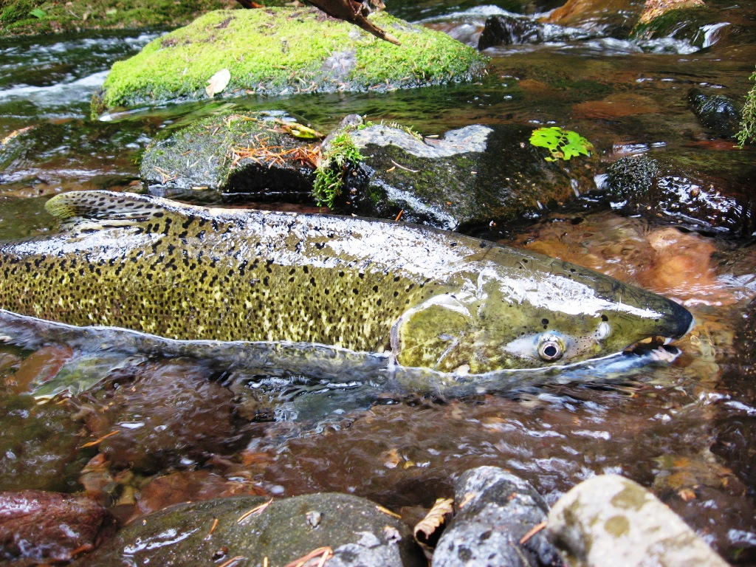
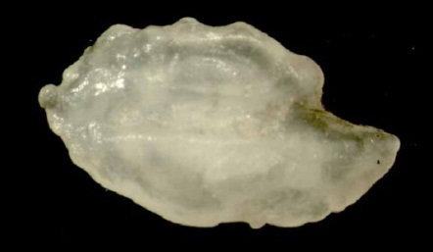
Agency principle
“Provide proactive & solution-based fish & wildlife management based on sound science.”
Photo: Brian Franklin

Slide 8
Database
Rapid increase in:
“Big data”; eco-informatics; systems biology
Data sharing, data mgmnt, transparency
Shared databases
Distributed research teams

Slide 9
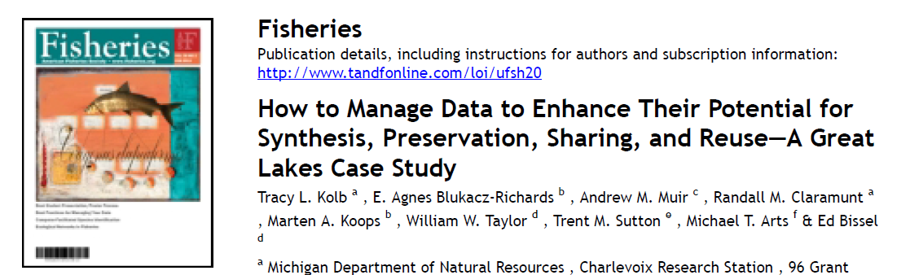
Database

Slide 10
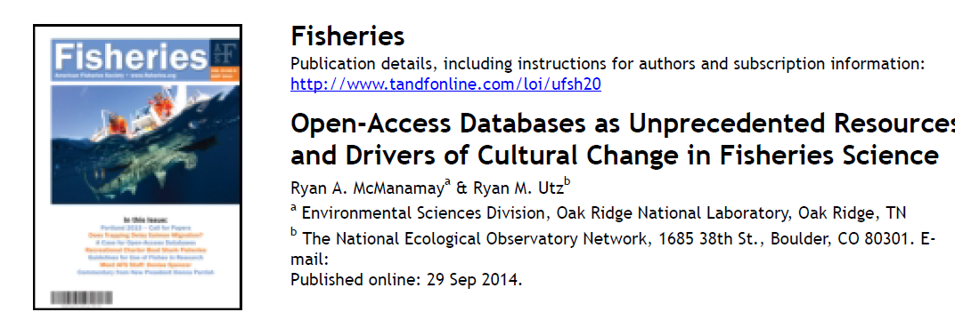
Database

Slide 11
Database

Slide 12
ODFW’s Willamette Chinook Salmon (OWCS) Database, β version
Relational database
Data from spawning ground surveys
Years 2000-2013; ~15,000 line records*
4 linked data tables
Carcass
Otolith
Scale
Survey data
Reference tables (rivers, sections, subbasins, metadata)
*All data provisional

Slide 13
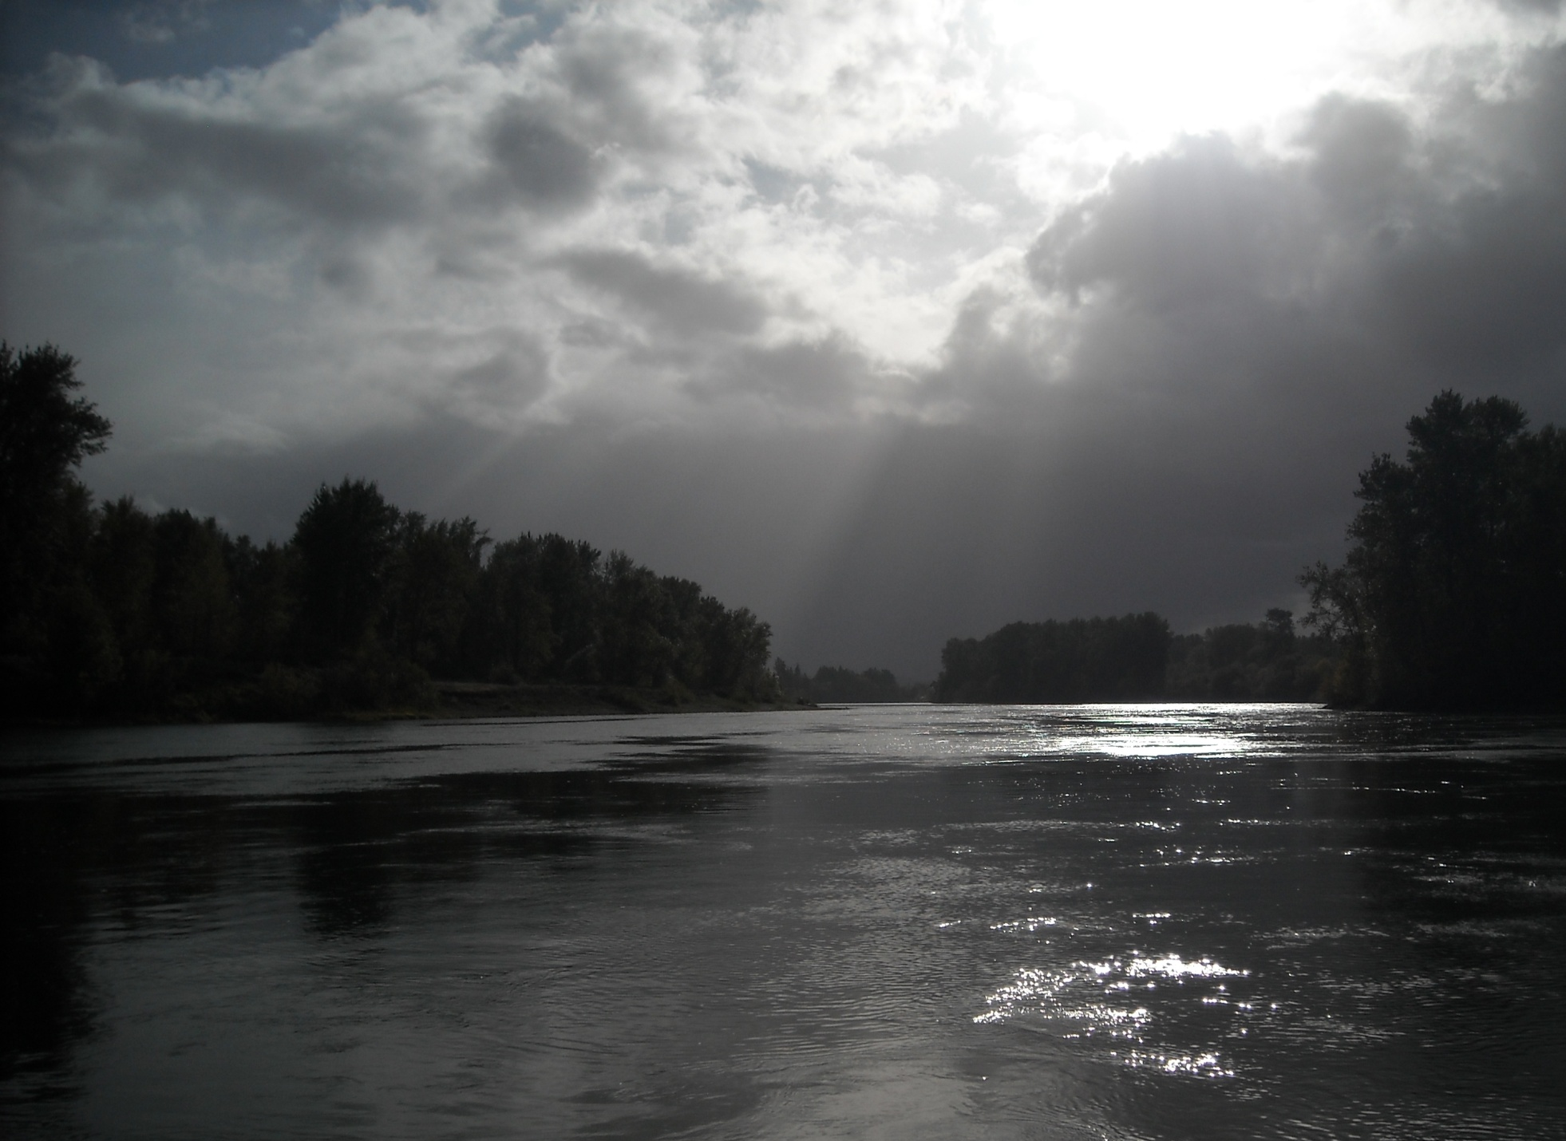
Meta data

Slide 14
Meta data
Table:“ref_Meta data”
Spawning ground surveys: protocol
Thermal mark ID
Methods for scale analyses
“cover letter”

Slide 15
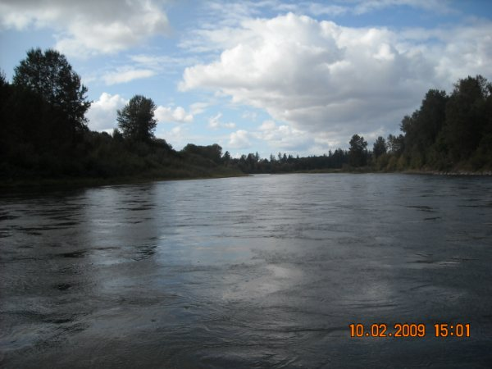
Benefits

Slide 16
Benefits
Version control
Data quality control, standardization
Accessibility; queriability
Quick data extraction → fast analyses
→ quickly inform mgmt

Slide 17
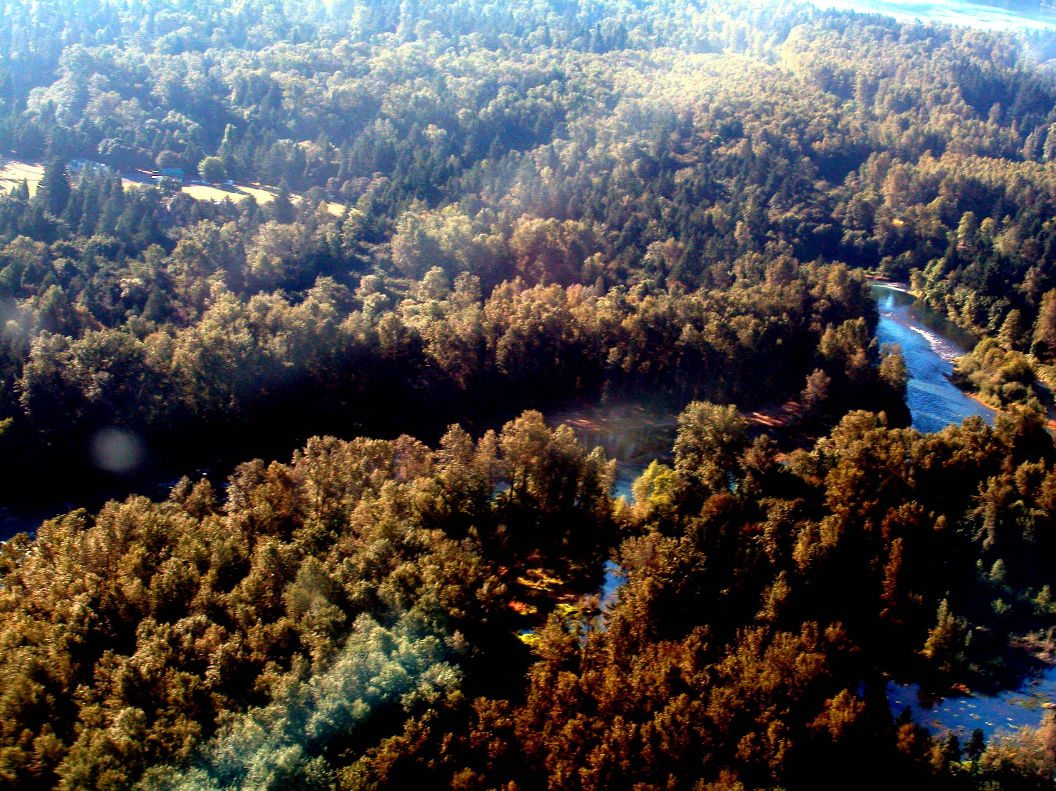
Data flow

Slide 18
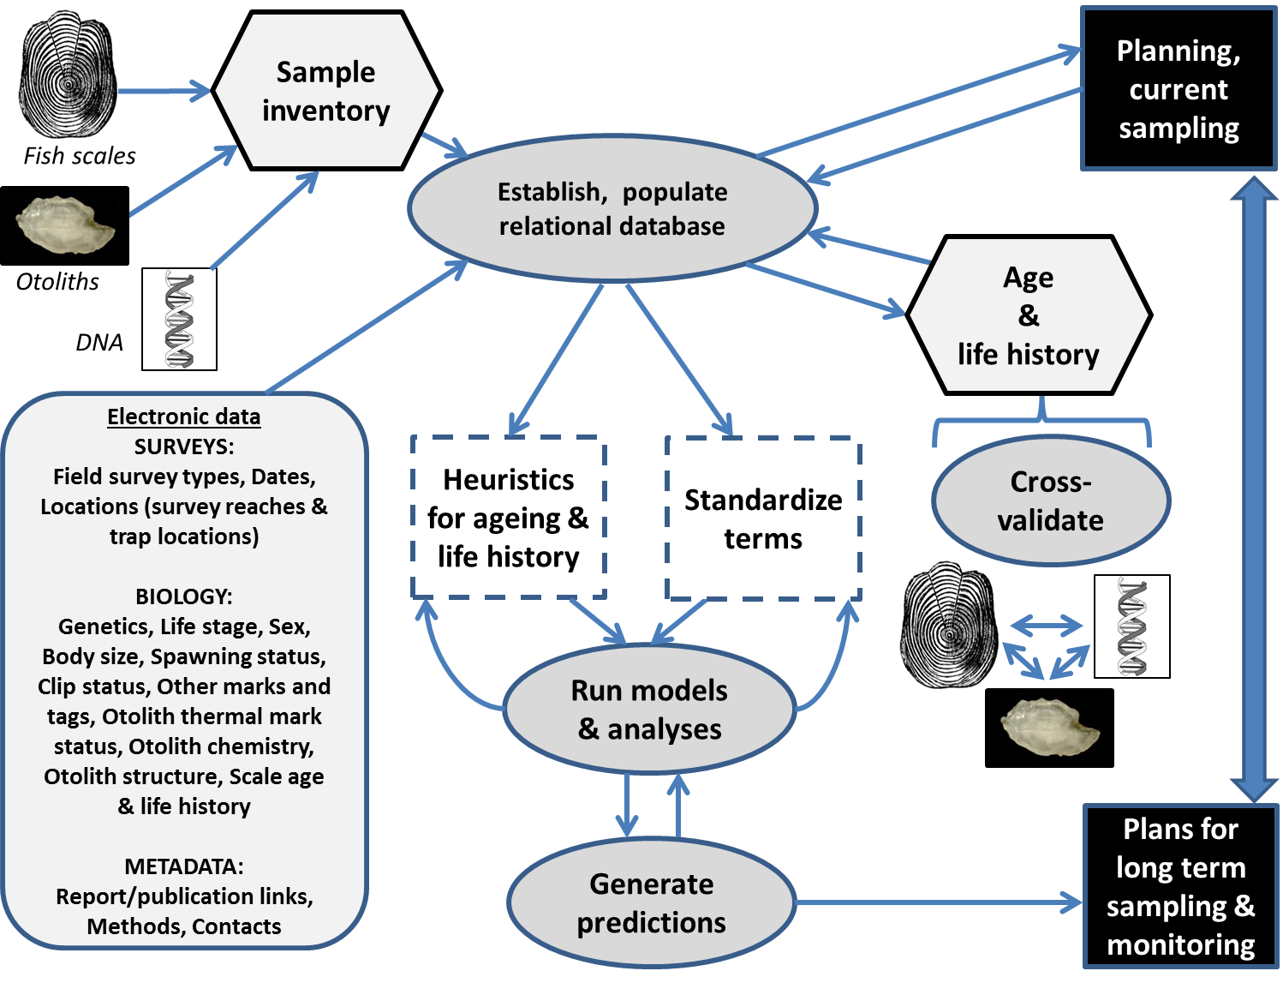

Slide 19
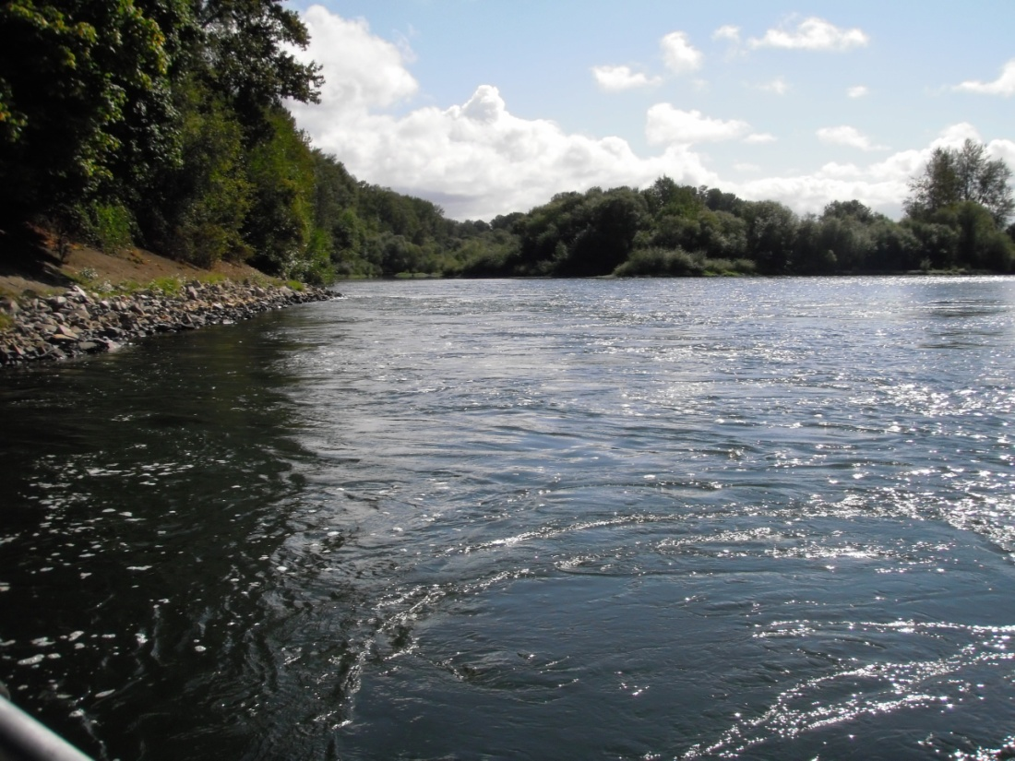
Outputs

Slide 20
Outputs
Life history modeling
SLAM modeling; SARs
Recent review of VSP modeling in Willamette (ISAB 2014): “In short, the modeling effort is far ahead of the empirical data needed to fit and verify the models. Consequently, model outputs (e.g., spawner abundances and VSP scores) are likely unreliable, and the absolute values should be interpreted cautiously”.
OWCS + environ. variables (ODEQ’s Heat Source model) = Systems biology

Slide 21
Database

Slide 24
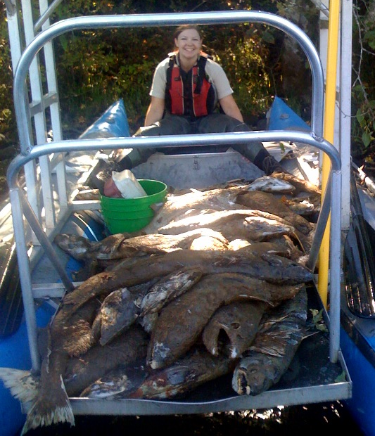
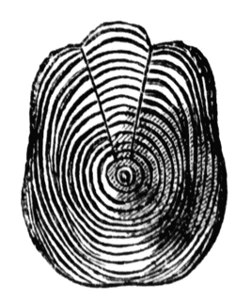
SurveyData
SurveyID (Key)
River bank (Key)
Otolith
SurveyID (Key)
VialNo (Key)
Carcass
CarcassID (Key)
SurveyID
VialNo
Scales
SurveyID (Key)
VialNo (Key)

Slide 25
Queries & Outputs
Examples….

Slide 26
Provisional

Slide 27
Example 1: Query on scales, 2002-2011 by life history
“normal” vs. “reservoir”

Slide 28
(subyearling or yearling)
‘03
‘04
‘06
‘07
‘08
‘09

Slide 29
Example 2: Filter query on master query
North Santiam, sections below Minto Fish Facility
Trends
No. redds
No. spawned fish
Age, origin of fish

Slide 31
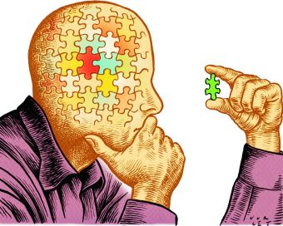

Slide 33
Note differences, carefully select
“SumOfReddCount” (MaterQuery table)
is not
“ReddCount” and “PeakCount” (data_Survey table)

Slide 35
Total age counts by origin

Slide 36
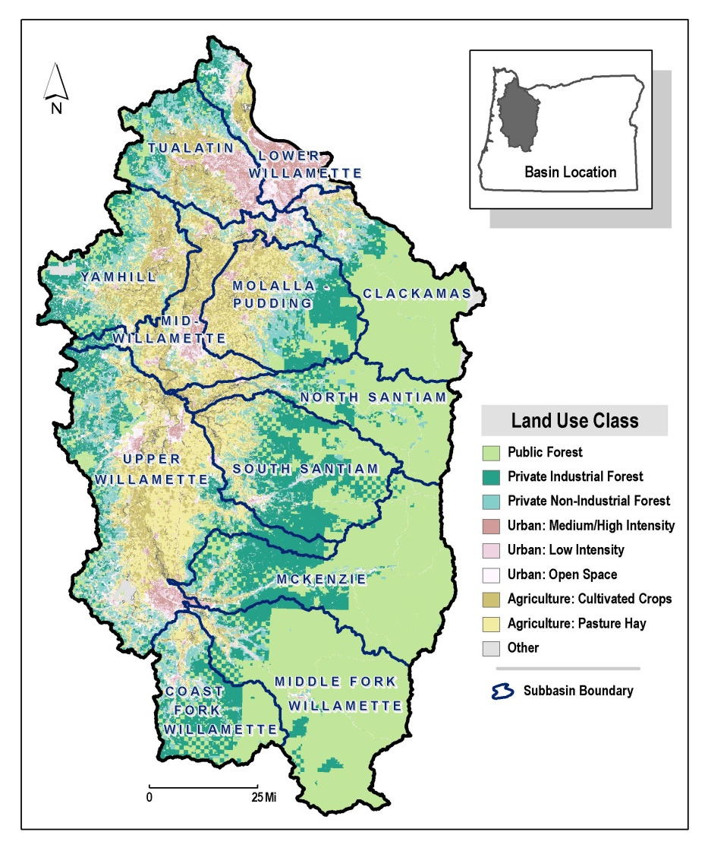
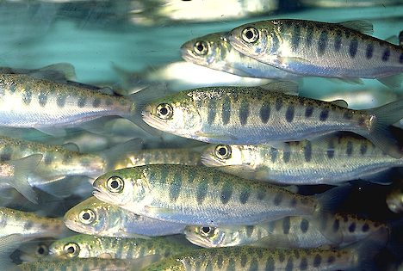
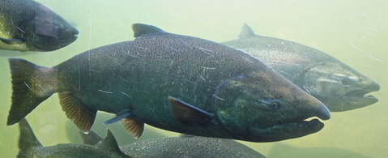
Synthesis

Slide 37
OWCS and ODFW fisheries management
Guiding statutory reference
Manage fisheries
OWCS database
ODFW mission
R, M & E
ODFW principle

Slide 38
Interested in collaborating?
Maintained by ODFW personnel.
Accessible to the COE, collaborating P.I.s, and on a case-by-case basis to other researchers, provided clear and rationale goals, methods, and analyses are provided in advance.
ODFW retains the right to provide input on any research projects stemming from use of this data, including the right to review and provide input on manuscripts that may arise from use of the data.
Acknowledgment of ODFW.
CONTACT:
Ben Clemens (Ben.Clemens@oregonstate.edu; 541-757-5113
Cameron Sharpe (Cameron.Sharpe@oregonstate.edu; 541-757-4153

Slide 39
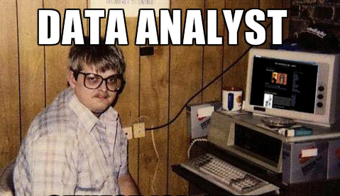
OWCS database

